Slide 1
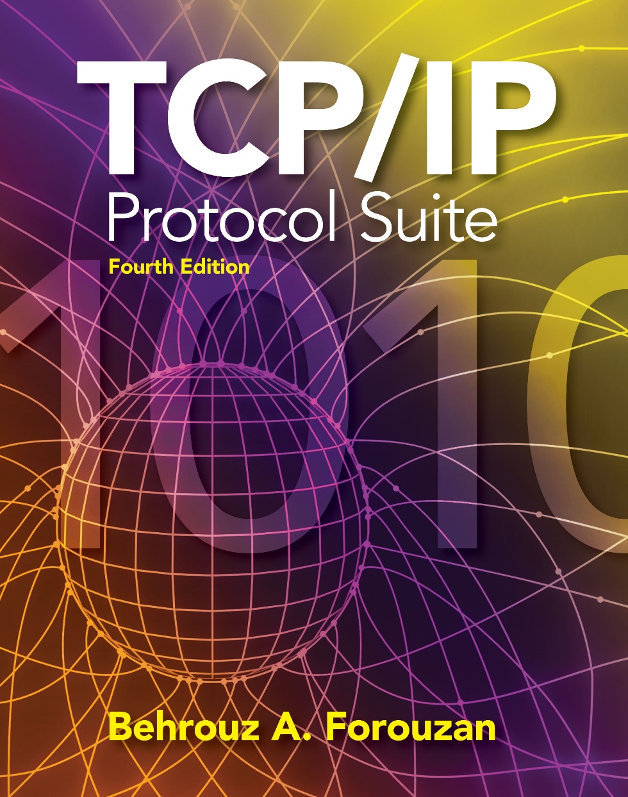
Chapter 3
Underlying Technology
Wired LANs
Copyright © The McGraw-Hill Companies, Inc. Permission required for reproduction or display.

Slide 2
IEEE LAN STANDARDS

Slide 3
WIRED LOCAL AREA NETWORKS
A local area network (LAN) is a computer network that is designed for a limited geographic area such as a building or a campus.
LANs today are also linked to a wide area network (WAN) or the Internet.
The LAN market has seen several technologies such as Ethernet(802.3), token ring (802.5), token bus(802.4), FDDI, and ATM LAN, but Ethernet(802.3) is by far the dominant technology.
Notes:
At first you might think this problem is so trivial(simple) that there is no software to study—machine A just puts the bits on
the wire, and machine B just takes them off.
Unfortunately, communication circuits make errors occasionally, finite data rate, propagation delay limitation puts limitation on the efficiency of the data transfer. The protocols used for communications must take all these factors into consideration.
think of the Internet as a series of backbone networks that are
run by international, national, and regional ISPs. The backbones
are joined together by connecting devices such as routers or switching
stations. The end users are either part of the local ISP LAN or connected
via point-to-point networks to the LANs.
Conceptually, the Internet is a set of switched WANs (backbones), LANs, point-to-point WANs, and
connecting or switching devices.
TCP/IP Protocol Suite is normally shown as a five-layer stack, it only defines the three upper layers;
TCP/IP is only concerned with the network, transport, and application layers.
This means that TCP/IP assumes the existence of these WANs, LANs, and the connecting devices
that join them.
We touch upon some of these underlying technologies- LAN(in this discussion) ,WAN, connecting device

Slide 4
IEEE STANDARDS
In 1985, the Computer Society of the IEEE started a project, called Project 802, to set standards to enable intercommunication among equipment from a variety of manufacturers. Project 802 is a way of specifying functions of the physical layer and the data link layer of major LAN protocols.
Topics discussed in this section(Underlying Technology):
Data Link Layer- LLC, MAC Physical Layer
Notes:
TcpIp illustrated -Vol-1.pdf
TCP/IP supports many different link layers, depending on the type of networking hardware being used: Ethernet, token ring, FDDI (Fiber
Distributed Data Interface), RS-232 serial lines, and the like.
The term Ethernet generally refers to a standard published in 1982 by Digital Equipment Corp., Intel Corp., and Xerox Corp.
It is the predominant form of local area network technology used with TCP/IP today.
It uses an access method called CSMA/CD, which stands for Carrier Sense, Multiple Access with Collision Detection. It operates at 10 Mbits/sec and uses 48-bit addresses.
IEEE 802.3 covers an entire set of CSMA/CD networks, 802.4 covers token bus networks, and 802.5 covers token Ring networks.

Slide 5
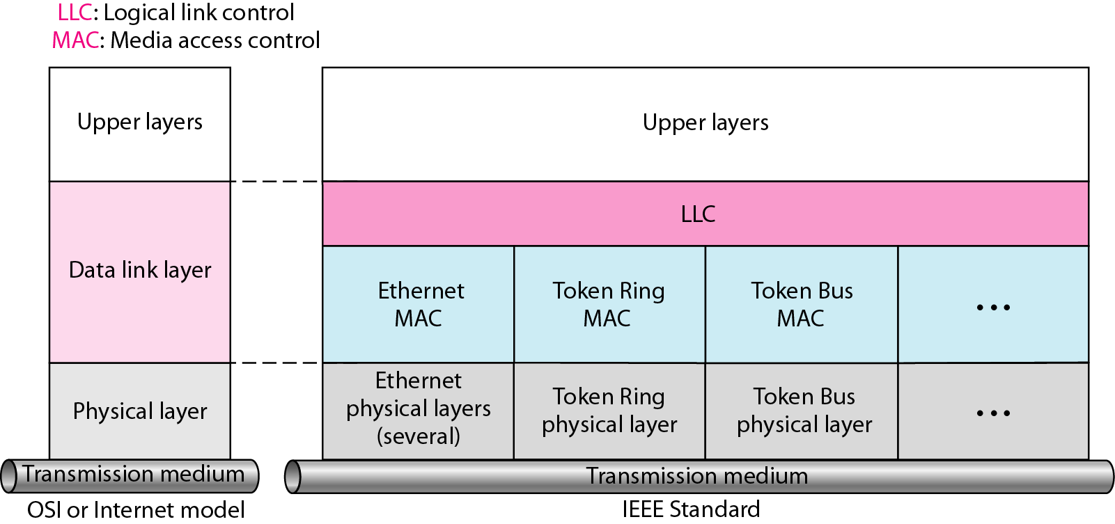
IEEE standard for LANs
LLC is responsible for handling multiple Layer3 protocols (multiplexing/de-multiplexing) and link services like reliability and flow control.
MAC is responsible for framing and media access control for broadcast media.
Notes:
Above multiplexing/de-multiplexing – is simultaneously transmitting frames of different sources(or frames containing data of different sender) and demultiplexing is reverese
Statistical multiplexing is a type of communication link sharing, very similar to dynamic bandwidth allocation (DBA). In statistical multiplexing, a communication channel is divided into an arbitrary number of variable bitrate digital channels or data streams. The link sharing is adapted to the instantaneous traffic demands of the data streams that are transferred over each channel. This is an alternative to creating a fixed sharing of a link, such as in general time division multiplexing (TDM) and frequency division multiplexing (FDM). When performed correctly, statistical multiplexing can provide a link utilization improvement, called the statistical multiplexing gain.

Slide 6
STANDARD ETHERNET
The original Ethernet was created in 1976 at Xerox’s Palo Alto Research Center (PARC). Since then, it has gone through four generations. We briefly discuss the Standard (or traditional) Ethernet in this section.

Slide 7
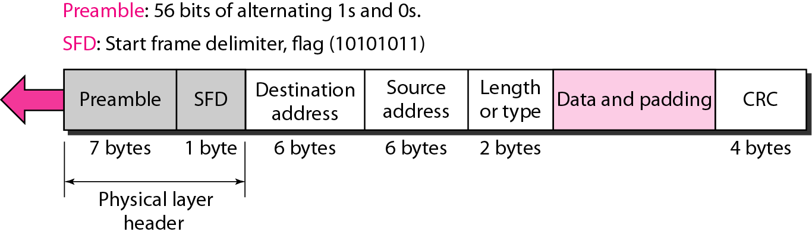
802.3 MAC frame
Notes:
Min – 64 bytes Max – 1518 bytes.
Preamble. The first field of the 802.3 frame contains 7 bytes (56 bits) of alternating
0s and 1s that alerts the receiving system to the coming frame and enables it to
synchronize its input timing. The pattern provides only an alert and a timing pulse.
The 56-bit pattern allows the stations to miss some bits at the beginning of the
frame. The preamble is actually added at the physical layer and is not (formally)
part of the frame.
Start frame delimiter (SFD). The second field (1 byte: 10101011) signals the
beginning of the frame. The SFD warns the station or stations that this is the last
chance for synchronization. The last 2 bits are 11 and alert the receiver that the
next field is the destination address. The SFD is also added at the physical layer.
Destination address (DA). The DA field is 6 bytes and contains the physical
address of the destination station or stations to receive the packet. We will discuss
addressing shortly.
❑ Source address (SA). The SA field is also 6 bytes and contains the physical
address of the sender of the packet.
❑ Length or type. This field is defined as a type field or length field. The original
Ethernet used this field as the type field to define the upper-layer protocol (Example- ARP protocol of Network layer may be using MAC frame,
in this case Type value will be 0x806)using the MAC frame.
The IEEE standard used it as the length field to define the number of bytes in the data field. Both uses are common today.
Data. This field carries data encapsulated from the upper-layer protocols. It is a
minimum of 46 Bytes and a maximum of 1500 bytes, as we will see later.
CRC (Cyclic Redundancy Check). The last field contains error detection information, in this case a CRC-32.

Slide 8
Preamble (7 bytes): used to synchronize receiver, sender clock rates.
SFD (1 byte): Start Frame Delimiter, flag (10101011): Signals the beginning of the frame. Last two bits 11 alert the receiver that the next field is the destination address.
Destination and source address: MAC address of source and destination.
Type/Length (2 Bytes): Length: Up to 1500 (max length)
Type: Identify higher-layer data(0x0800 –IPv4 , 0x0806-ARP)
CRC(Cyclic Redundancy Check 4 Bytes): checked at receiver, if error is detected, the frame is simply dropped
Data: 46 to 1500 Bytes (if shorter: add pad)Why? (explained after CSMA/CD)
Notes:
3.2.6 Length/Type field-
This two-octet field takes one of two meanings, depending on its numeric value. For numerical evaluation, the first octet is the most significant octet of this field.
If the value of this field is less than or equal to the value of maxValidFrame (as specified in 4.2.7.1)1500 decimal, then the Length/Type field indicates the number of MAC client data octets contained in the subsequent data field of the frame (Length interpretation).
b) If the value of this field is greater than or equal to 1536 decimal (equal to 0600 hexadecimal), then the Length/Type field indicates the nature of the MAC client protocol (Type interpretation). For example, an Type value of 0x0800 signals that the frame contains an IPv4 datagram. Likewise, an Type of 0x0806 indicates an ARP frame

Slide 9
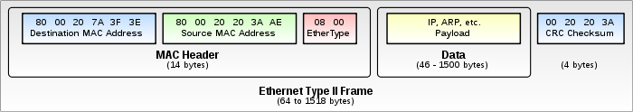
Example: IEEE802.3 frame
Notes:
Example: IEEE802.3 frame

Slide 10
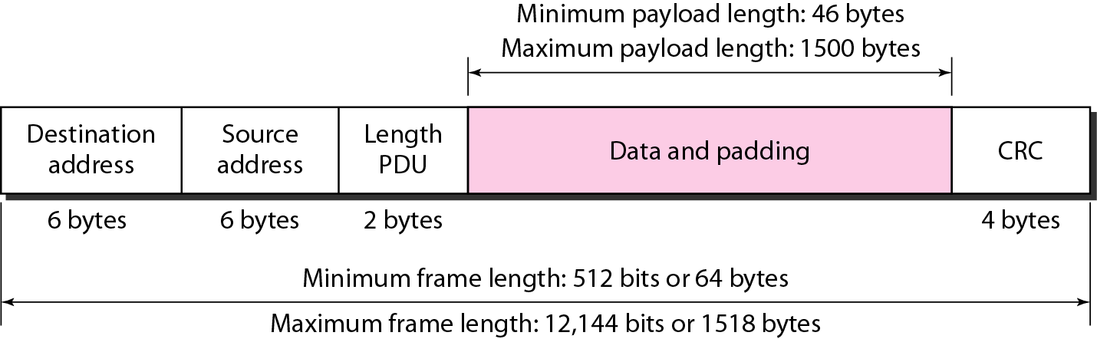
Minimum and maximum lengths
Min Frame Length
46 byte min Data payload + 18bytes Header &CRC =64 bytes.
Max Frame Length
1500 byte max Data payload + 18bytes Header &CRC=1518 bytes
Notes:
2 reasons –
This collision detection requirement also defines the maximum propagation delay along the cable, and hence the maximum cable segment length. 46byte Data payload+18bytes Header &CRC =6 bytes At the other end of the range - 1500 bytes, there were two factors that lead to the introduction of this limit. First, if the packets are too long, they introduce extra delays to other traffic using the Ethernet cable. The other factor was a safety device built into the early shared cable transceivers. This safety device was an anti-babble system. If the device connected to a transceiver developed a fault and started transmitting continuously, then it would effectively block any other traffic from using that Ethernet cable segment. To protect from this happening, the early transceivers were designed to shut off automatically if the transmission exceeded about 1.25 milliseconds. This equates to a data content of just over 1500 bytes. However, as the transceiver used a simple analogue timer to shut off the transmission if babbling was detected, then the 1500 limit was selected as a safe approximation to the maximum data size that would not trigger the safety device.
Babble: An error condition caused by an Ethernet node transmitting longer packets than allowed. Sometimes babble is used interchangeably with jabber.
1.25*10⁻³ * 10*10⁶= 1250 bytes
However, as the transceiver used a simple analogue timer to shut off the transmission if babbling was detected, then the 1500 limit was selected as a safe approximation to the maximum data size that would not trigger the safety device.

Slide 11

Note
Frame length:
Minimum: 64 bytes (512 bits) Maximum: 1518 bytes (12,144 bits)
Notes:
2 reasons – memory was expensive. Fairness problem.

Slide 12
Problem
An Ethernet MAC sublayer receives 1510 bytes of data from the upper layer. Can the data be encapsulated in one frame? If not, how many frames need to be sent? What is the size of the data in each frame?
Solution
The maximum data size in the Standard Ethernet is 1500 bytes. The data of 1510 bytes, therefore, must be split between two frames.
The standard dictates that the first frame must carry the maximum possible number of bytes (1500);
the second frame then needs to carry only 10 bytes of data (it requires
padding). The following shows the breakdown:
Data size for the first frame: 1500 bytes
1st Frame Size =1500 data + 18 header & CRC =1518 Bytes
Data size for the second frame: 46 bytes (10 Payload+36 padding)
2nd Frame Size =46 Byte Data + 18 header & CRC =64 Bytes
Notes:
Number of frames required to transmit

Slide 13
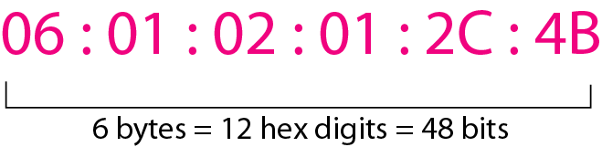
Example of an Ethernet address in hexadecimal notation
48 bits (6 bytes) in length
Uniquely assigned to each Ethernet network interface card (NIC)
Usually written in hexadecimal notation
Notes:
Each station on an Ethernet network (such as a PC, workstation, or printer) has its own
network interface card (NIC). The NIC fits inside the station and provides the station
with a 6-byte physical address. As shown in Figure 3.4, the Ethernet address is 6 bytes
(48 bits), normally written in hexadecimal notation, with a colon between the bytes.
The address normally is referred to as the data link address, physical address, or MAC
address.

Slide 14
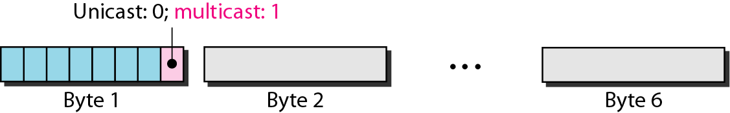
Unicast and multicast MAC addresses
The least significant bit of the first byte defines the type of address. If the bit is 0, the address is unicast; otherwise, it is multicast.
A multicast address can be a destination address, but not a source address

Slide 15
Note
The broadcast destination address is a special case of the multicast address in which all bits are 1s.

Slide 16
Example 3.2
Show how the address 47:20:1B:2E:08:EE is sent out on line.
Solution
The address is sent left-to-right, byte by byte; for each byte, it is sent right-to-left, bit by bit, as shown below:
← 11100010 00000100 11011000 01110100 00010000 01110111
Decimal value 7=0111
Decimal value 4=0100
Decimal value E=1110
Decimal value E=1110
47 is 0100 0111
The right-to-left order is
1110 0010 – LSB is 1 Multicast
The transmission is left-to-right, byte by byte; however, for each byte, the least significant bit is sent first and the most significant bit is sent last. This means that the bit that defines
an address as unicast or multicast arrives first at the receiver.

Slide 17
Example
Define the type of the following destination addresses:
a. 4A:30:10:21:10:1A b. 47:20:1B:2E:08:EE
c. FF:FF:FF:FF:FF:FF
Solution
To find the type of the address, we need to look at the second hexadecimal digit from the left. If it is even, the address is unicast. If it is odd, the address is multicast. If all digits are F’s, the address is broadcast. Therefore, we have the following:
a. This is a unicast address because A in binary is 1010.
b. This is a multicast address because 7 in binary is 0111.
c. This is a broadcast address because all digits are F’s.

Slide 18
Meaning of some Terms
Propagation Delay(T_{p}): Amount of time it takes for the first bit of signal to travel from the sender to the receiver.
T_{P} = d/c where d is the distance between the sender and the receiver and c is the speed of light ( 3 * 10^8 m/s).
Transmission Delay(T_{d}): It is the amount of time required to push all of the packet's bits into the wire. In other words, this is the delay caused by the data-rate of the link.
Transmission delay is a function of the packet's length and has nothing to do with the distance between the two nodes. This delay is proportional to the packet's length in bits. It is given by the following formula:
T_{d} = N/R where N is the number of bits, and R is the rate of transmission (say in bits per second)
Notes:
Meaning of some Terms

Slide 19
Solution
The stations on a wireless network are a maximum of 300 km apart. If the network transmits 400-bit frames on a shared channel of 200 kbps. Find the propagation and Transmission Delay
Solution
Propagation Delay : = T_{P} = d/c
=300 X 1000 / 3 X 10^8 =0.001 sec= 1ms
Transmission delay = T_{d} = N/R
400/(200 X 10^3) = =0.002 sec=2ms

Slide 20
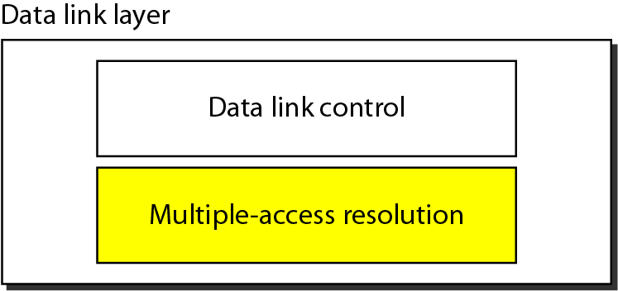
Data link layer divided into two functionality-oriented sublayers
The upper sublayer that is responsible for flow and error control is called the logical link control (LLC) layer;
The lower sublayer that is mostly responsible for Media Access Control
Notes:
We can consider the data link layer as two sublayers. The upper sublayer is responsible
for data link control, and the lower sublayer is responsible for resolving access to the
shared media. If the channel is dedicated, we do not need the lower sublayer.
The upper sublayer that is responsible for flow and error control is called the logical
link control (LLC) layer; the lower sublayer that is mostly responsible for multiple access
resolution is called the media access control (MAC) layer.
When nodes or stations are connected and use a common link, called a multipoint
or broadcast link, we need a multiple-access protocol to coordinate access to the link.
The problem of controlling the access to the medium is similar to the rules of speaking in assembly.

Slide 21
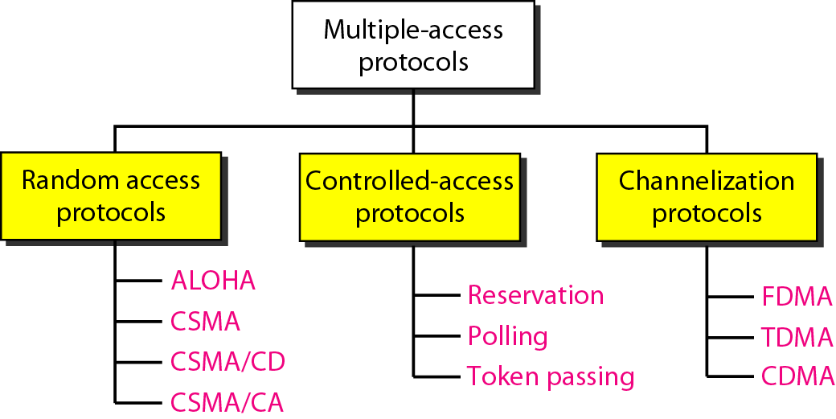
Taxonomy of multiple-access protocols discussed in this chapter
Notes:
In random access or contention(struggle) methods, no station is superior to another station and
none is assigned the control over another. No station permits, or does not permit,
another station to send. At each instance, a station that has data to send uses a procedure
defined by the protocol to make a decision on whether or not to send.
Controlled-Access Protocols:
In controlled access, the stations consult one another to find which station has the right
to send. A station cannot send unless it has been authorized by other stations.
Channelization is a multiple-access method in which the available bandwidth of a link
is shared in time, frequency, or through code, between different stations. In this section,
we discuss three channelization protocols: FDMA, TDMA, and CDMA.

Slide 22
RANDOM ACCESS
In random access or contention methods, no station is superior to another station and none is assigned the control over another.
No station permits, or does not permit another station to send.
At each instance, a station that has data to send follows a procedure defined by the protocol to make a decision on whether or not to send.
Notes:
Contend: to compete in order to win something

Slide 23
Two features give this method its name.
First, there is no scheduled time for a station to transmit. Transmission is random among the stations. That is why these methods are called random access.
Second, no rules specify which station should send next. Stations compete with one another to access the medium. That is why these methods are also called contention methods.
In a random access method, each station has the right to the medium without being controlled by any other station. However, if more than one station tries to send, there is an access conflict-collision-and the frames will be either destroyed or modified
Notes:
No Schedule
Who to Send Next
Collision

Slide 24
To avoid access conflict or to resolve it when it happens, each station follows a procedure that answers the following questions:
When can the station access the medium?
What can the station do if the medium is busy?
How can the station determine the success or failure of the transmission?
What can the station do if there is an access conflict?

Slide 25
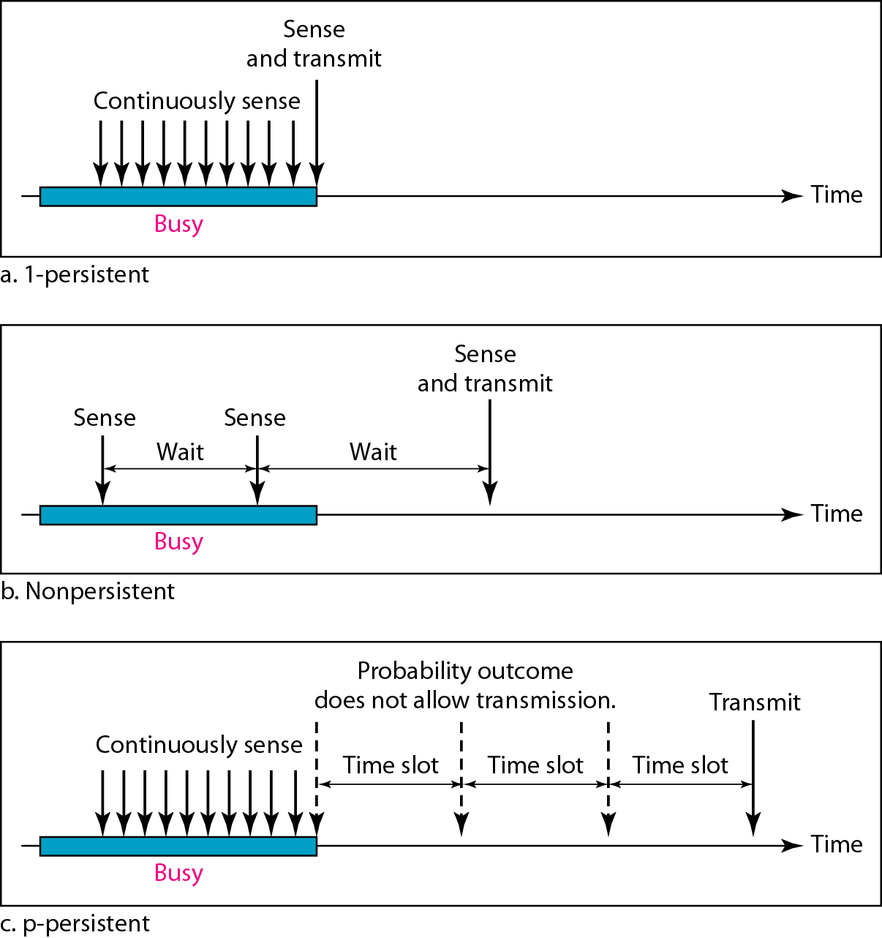
Behavior of three persistence methods
Persistent Methods –tells what to do if media sensed is busy or if idle?
Notes:
Persistent Methods –tells what to if media sensed is busy or if idle?

Slide 26
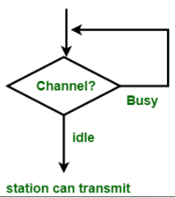
1-persistent CSMA
1-persistent CSMA (Carrier Sense Multiple Access): To send data, a station first listens to the channel to see if anyone else is transmitting.
If so, the station waits (keeps sensing it) until the channel becomes idle. Otherwise, it transmits a frame.
If a collision occurs, the station waits a random amount of time and starts all over again.

Slide 27
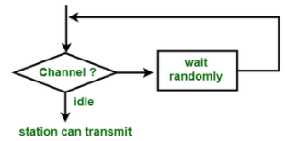
Non-persistent CSMA
To send data, a station first listens to the channel to see if anyone else is transmitting.
If so, the station waits a random period of time (instead of keeping sensing until the end of the transmission) and repeats the algorithm. Otherwise, it transmits a frame.
If a collision occurs, the station waits a random amount of time and starts all over again.

Slide 28
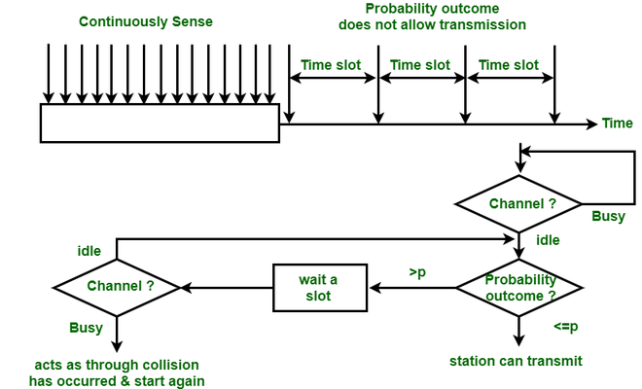
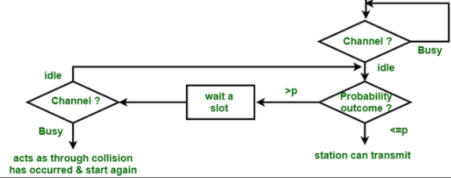
P-Persistent CSMA
The p-persistent method is used if the channel has time slots with a slot duration equal to or greater than the maximum propagation time.
In this method, after the station finds the line idle it follows these steps:
1. With probability p, the station sends its frame.
2. With probability q = 1 - p, the station waits for the beginning of the next time slot and checks the line again.
a. If the line is idle, it goes to step 1.
b. If the line is busy, it acts as though a collision has occurred and uses the back off procedure.

Slide 29
CSMA/CD
Carrier Sense Multiple Access with Collision Detection (CSMA/CD) augments the algorithm to handle the collision.
In this method, a station monitors the medium after it sends a frame to see if the transmission was successful.
If a collision is detected the station aborts the transmission.
No Acknowledgment
Notes:
No acknowledgement is used ,hence sender ensures delivery by observing Collision in the media while transmitting(Collision Detection)

Slide 30
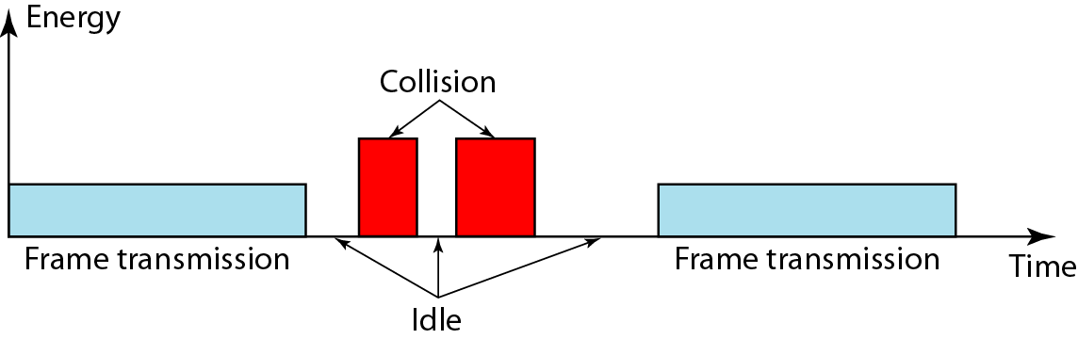
Energy level during transmission, idleness, or collision
Notes:
3 levels of energy – zero, normal and abnormal.
Energy Level
We can say that the level of energy in a channel can have three values: zero, normal,
and abnormal. At the zero level, the channel is idle. At the normal level, a station has
successfully captured the channel and is sending its frame. At the abnormal level, there
is a collision and the level of the energy is twice the normal level. A station that has a
frame to send or is sending a frame needs to monitor the energy level to determine if
the channel is idle, busy, or in collision mode.

Slide 31
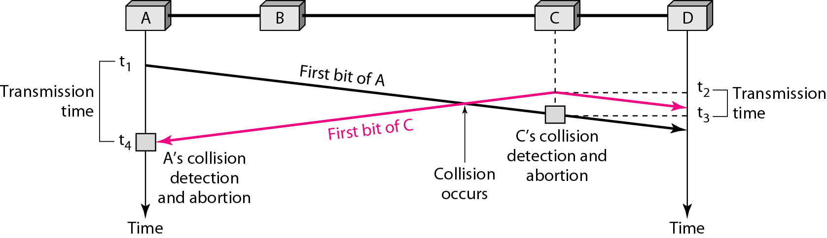
Collision of the first bit in CSMA/CD
Collision is detected by every station in the Network
Notes:
Collision is detected by every station in the Network
At time t1, station A has executed its persistence procedure and starts sending the
bits of its frame. At time t2, station C has not yet sensed the first bit sent by A. Station C
executes its persistence procedure and starts sending the bits in its frame, which propagate
both to the left and to the right. The collision occurs sometime after time t2' Station C
detects a collision at time t3 when it receives the first bit of A's frame. Station C immediately
(or after a short time, but we assume immediately) aborts transmission. Station A
detects collision at time t4 when it receives the first bit of C's frame; it also immediately
aborts transmission. Looking at the figure, we see that A transmits for the duration t4 – t1;
C transmits for the duration t3 - t2' Later we show that, for the protocol to work, the
length of any frame divided by the bit rate(i.e. time required to transmit entire frame on to link)
in this protocol must be more than either of these durations. At time t4, the transmission of A’s frame, though incomplete, is aborted; at time t3, the transmission of B's frame, though incomplete, is aborted.
Now that we know the time durations for the two transmissions, we can show a
more complete graph in Figure

Slide 32
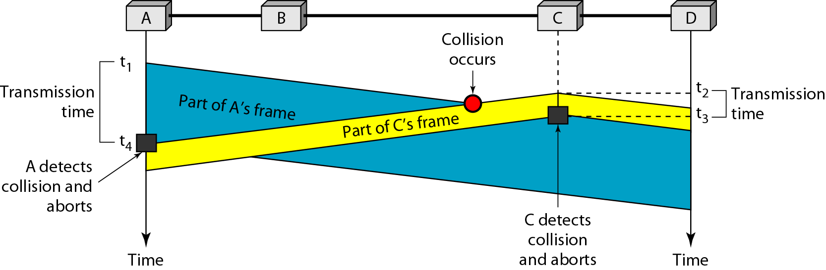
Collision and abortion in CSMA/CD
(t₄-t₁)*data rate –amount of data transmitted by A before detecting collision.
Notes:
(t4-t1)*data rate –amount of data transmitted by A before detecting collision.

Slide 33
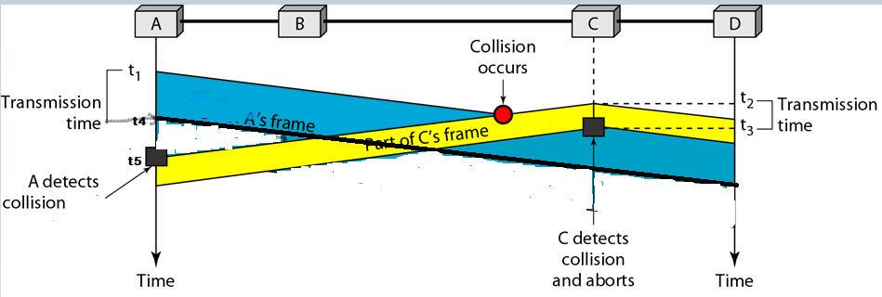
What if Frame size is smaller?
Station ‘A’ never understands that- collision happened with it’s own Signal
Once the entire frame is sent, does not keep a copy of the frame and does not monitor the link for collision detection.
Notes:
What if Frame size is smaller?
A never understands that- collision Happened with it’s own Signal

Slide 34
Minimum Frame Size
For CSMA/CD to work, we need a restriction on the frame size. Before sending the last bit of the frame, the sending station must detect a collision, if any, and abort the transmission.
This is so because the station, once the entire frame is sent, does not keep a copy of the frame and does not monitor the link for collision detection.
In the worst case scenario, If the two stations involved in a collision are the maximum distance apart, the signal from the first takes time T_{p} to reach the second, and the effect of the collision takes another time T_{p} to reach the first
Therefore, the frame transmission delay T_{fr}(also called as T_{d} in slide 19)must be at least two times the maximum propagation time T_{p}
T_{fr}>=2*T_{p}
Notes:
For CSMA/CD to work, we need a restriction on the frame size. Before sending the last bit of the frame, the sending station must detect a collision, if any, and abort the transmission. This is so because the station, once the entire frame is sent, does not keep a copy of the frame and does not monitor the line for collision detection. Therefore, the frame transmission time Tfr must be at least two times the maximum propagation time Tp.
To understand the reason, let us think about the worst-case scenario. If the two stations involved in a collision are the maximum distance apart, the signal from the first takes time Tp to reach the second and the effect of the collision takes another time Tp to reach the first. So the requirement is that the first station must still be transmitting after 2Tp .
T_{fr} >= 2T_{p}
T_{fr} = N/R where N- Length of packet in terms of bits; R-Data rate
N/R >= 2T_{p}
N>=2T_{p} * R
We know T_{p} = d/c where d –distance i.e. length of cable c- speed of light(signal-for copper wire 2/3 of speed of light)
N>=2*d/c * R
Chapter 13-pdf page 438-439
Standard Ethernet uses 1-persistent CSMA/CD (see Chapter 12).
Slot Time In an Ethernet network, the round-trip time required for a frame to travel
from one end of a maximum-length network to the other plus the time needed to send
the jam sequence is called the slot time.
Slot time =round-trip time + time required to send the jam sequence
The slot time in Ethernet is defined in bits. It is the time required for a station to
send 512 bits. This means that the actual slot time depends on the data rate; for traditional
10-Mbps Ethernet it is 51.2 micro-sec.
Slot Time and Collision The choice of a 512-bit slot time was not accidental. It was
chosen to allow the proper functioning of CSMA/CD. To understand the situation, let
us consider two cases.
In the first case, we assume that the sender sends a minimum-size packet of 512 bits.
Before the sender can send the entire packet out, the signal travels through the network
and reaches the end of the network. If there is another signal at the end of the network
(worst case), a collision occurs. The sender has the opportunity to abort the sending of
the frame and to send a jam sequence to inform other stations of the collision. The
round-trip time plus the time required to send the jam sequence should be less than the
time needed for the sender to send the minimum frame, 512 bits. The sender needs to
be aware of the collision before it is too late, that is, before it has sent the entire frame.
In the second case, the sender sends a frame larger than the minimum size
(between 512 and 1518 bits). In this case, if the station has sent out the first 512 bits and
has not heard a collision, it is guaranteed that collision will never occur during the
transmission of this frame. The reason is that the signal will reach the end of the network
in less than one-half the slot time. If all stations follow the CSMA/CD protocol,
they have already sensed the existence of the signal (carrier) on the line and have
refrained from sending. If they sent a signal on the line before one-half of the slot time
expired, a collision has occurred and the sender has sensed the collision. In other
words, collision can only occur during the first half of the slot time, and if it does, it can
be sensed by the sender during the slot time. This means that after the sender sends the
first 512 bits, it is guaranteed that collision will not occur during the transmission of
this frame. The medium belongs to the sender, and no other station will use it. In other
words, the sender needs to listen for a collision only during the time the first 512 bits
are sent.
Ofcourse, all these assumptions are invalid if a station does not follow the CSMAlCD
protocol. In this case, we do not have a collision, we have a corrupted station.

Slide 35
T_{fr}>=2*T_{p} Sender must have enough bits so that Transmission delay (T_{d} or T_{fr} Time for transmitting all bits of frame)
T_{fr} >= 2 * T_{p} and T_{d} = N/R
N- length of frame in bits
R- Data rate
N/R >= 2 * T_{p}
N>=2 * T_{p} * R
Frame Size >= (2 * T_{p})* R
Frame Size >= (2 * d/c)* R
because T_{P} = d/c

Slide 36
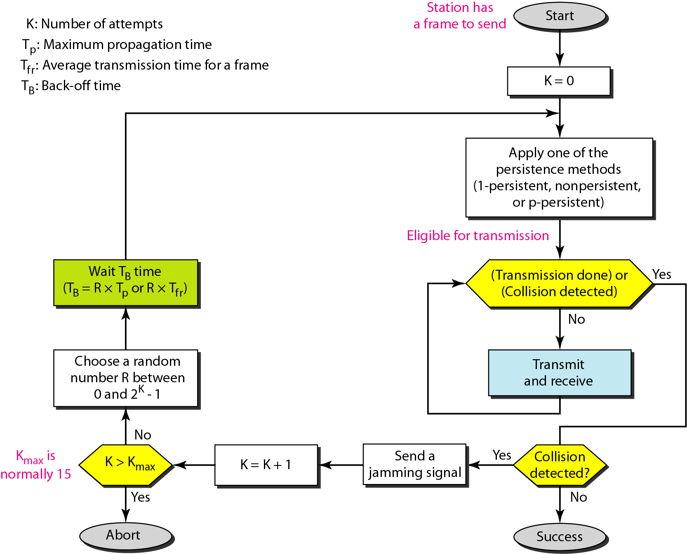
Flow diagram for the CSMA/CD
Persistent Methods –tells what to do if media sensed is busy or if idle?
Notes:
We need to sense the channel before we start sending the frame by using one of the persistence processes we discussed previously (non-persistent, 1-persistent, or p-persistent)
In CSMA/CD, transmission and collision detection is a continuous process. We do not send the entire frame and then look for a collision.
We use a loop to show that transmission is a continuous process. We constantly monitor in order to detect one of two conditions: either transmission is finished or a collision is detected. Either event stops transmission. When we come out of the loop, if a collision has not been detected, it means that transmission is complete; the entire frame is transmitted. Otherwise, a collision has occurred.
The third difference is the sending of a short jamming signal that enforces the collision
in case other stations have not yet sensed the collision.
A short jamming signal that enforces the collision in case other stations have not yet sensed the collision.

Slide 37
Example
A network using CSMA/CD has a bandwidth of 10 Mbps. If the maximum propagation time (including the delays in the devices and ignoring the time needed to send a jamming signal, as we see later) is 25.6 μs, what is the minimum size of the frame?
Solution
The frame transmission time is T_{fr} = 2 × T_{p} = 51.2 μs. This means, in the worst case, a station needs to transmit for a period of 51.2 μs to detect the collision.
The minimum size of the frame is 10 Mbps × 51.2 μs = 512 bits or 64 bytes. This is actually the minimum size of the frame for Standard Ethernet.
Notes:
What if a packet is of lesser size than minimum size then, extra padding bits needed to ensure that sent frame is of minimum size.

Slide 38
Problem
In a CSMA/CD network with a data rate of 10 Mbps, the minimum frame size is found to be 512 bits for the correct operation of the collision detection process.
What should be the minimum frame size if we increase the data rate to 100 Mbps? To 1 Gbps? To 10 Gbps?
Notes:
T_{fr} = N/D N-length of frame(in bits) D-data rate
T_{fr}=2*T_{p}
N/D=2*T_{P}
N= D*2*T_{P}

Slide 39
Solution
Let us find the relationship between the minimum frame size and the data rate. We
know that-
or
(frame size) = [2 × (distance) / (propagation speed)] × (data rate)]
or
frame size = K × (data rate)
This means that minimum frame size is proportional to the data rate (K is a constant).
When the data rate is increased, the frame size must be increased in a network with a fixed length to continue the proper operation of the CSMA/CD.
We calculate the minimum frame size based on the above proportionality relationship
Data rate = 10 Mbps → minimum frame size = 512 bits
Data rate = 100 Mbps → minimum frame size = 5120 bits
Data rate = 1 Gbps → minimum frame size = 51,200 bits
Data rate = 10 Gbps → minimum frame size = 512,000 bits
Frame Size >= (2 * T_{p})* R
Frame Size >= (2 * d/c)* R
Notes:
N/R = 2*d/c
T_{fr} = N/R N-length of frame(in bits) R-data rate
T_{fr}=2*T_{p}
N/R=2*T_{P}
N= R*2*T_{P}
There is also a new “Auto Negotiation” feature, which allows Fast Ethernet (100Mbps)
to talk to the regular Ethernet (10Mbps).
In Gig Ethernet, it would be necessary to reduce the LAN size to 25 m in order to retain the min frame size of 64 bytes. Instead, Gigabit Ethernet uses a bigger slot size of 512 bytes. To maintain compatibility with Ethernet, the minimum frame size is not increased, but the "carrier event" is extended. If the frame is shorter than 512 bytes, then it is padded with extension symbols. These are special symbols, which cannot occur in the payload. This process is called Carrier Extension (performed by the NIC card in hardware and is stripped away before the FCS is calculated on the receiving side
T_{P} =d/c d-distance c-signal speed=light speed. It is fixed for given network(in example, only data rate is changed , but distance and signal speed remains same)
N=R*K where K- constant
N proportional to R
If R=10Mbps , min N=512 bits
If R=100Mbps, min N also increase by that 5120 bits

Slide 40
Fast Ethernet
Fast Ethernet operates at 100Mbps. For the most part, the scheme/protocol remains the same as the 10Mbps case, except now the maximum length of the network is shortened.
Minimum frame size is still kept at 64 bytes (for backward compatibility), which now arrive 10 times faster than they do in 10Mbps Ethernet.
Frame Size >= (2 * T_{p})* R
Hence the maximum length of the network must be 10 times smaller or about around 250 meters.
Frame Size >= (2 * d/c)* R
Notes:
TCP/IP Protocol Suite

Slide 41
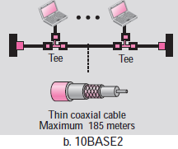
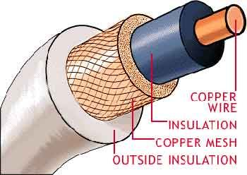
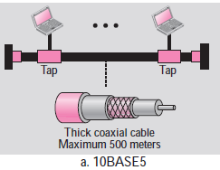
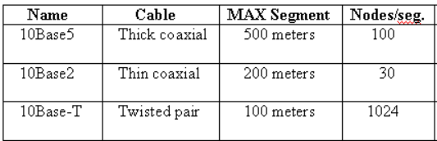
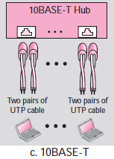
IEEE 802.3 (Ethernet) Cabling
10Base5 cabling: This type of cabling is popularly referred to as thicknet. It was one of the earliest types of cables used for LAN’s. The notation 10Base5 suggests that the LAN operates at 10 Mbps, uses baseband signaling and can support segments of up to 500 meters.
10Base2 cabling: 10Base2 or thinnet, which in contrast to thicknet, bends easily. 10Base2 cables are easier to install and are relatively inexpensive. The only drawback of using the 10Base2 cable is that it can run for only 200 meters and can handle only 30 stations per cable segment.
10Base-T cabling: there is no single, main cable because each station has a cable running to a central hub (a big repeater). Adding or removing stations is simpler in this configuration and cable breaks can be detected easily. The disadvantage of 10Base-T is that the maximum cable run from the hub is only 100 meters, sometimes 150 meters (if high quality twisted pairs are used). 10Base-T is most popular due to the ease of maintenance.
Notes:
10Base5 translates to 10 Mbps (theoretical transmission rate), Baseband (one transmission at a time over a single, shared channel), and 500 meters maximum segment length.
10Base5: Connections to this cable are made using vampire taps, in which a pin is carefully forced halfway into the coaxial cable’s core.
10 Base2: Connections to this cable are made using industry standard BNC connectors to form T-junctions.
10 BaseF: uses fiber optics; max segment length = 2000 m and supports 1024 nodes/seg; best between buildings; more expensive

Slide 42
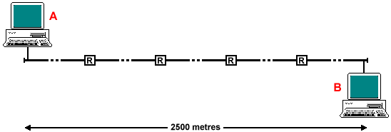
IEEE 802.3 (Ethernet)
IEEE 802.3 has a certain maximum cable length/segment. To allow larger networks, multiple cables are connected by repeaters which amplifies and retransmits signals in both directions.
Maximum distance between any 2 stations is 2500 m (with 5 segments each of 500 m) and no more than 4 repeaters (assume delay added by repeater- 3µSec) can separate any 2 stations.
Notes:
In practice, maximum distance between any 2 stations is 1500 m and no more than 2 repeaters can separate any 2 stations.

Slide 43
Why must the IEEE 802.3 (Ethernet) frame be at least 64 bytes long?
Calculations:
Data rate =10Mbps
LAN Length (L) = 500 m (per segment) x 5 segments = 2500 meters
Velocity of propagation on the cable (V) = 2 * 10⁸ meters/sec
Delay added by repeater (D) = ~3µSec x 2 (Bi-Direction) x 4 Repeaters = 24µSec
Round Trip Delay (RTD) i.e. 2*T_{P}= (Total Distance/V) + Repeater Delays (D)
Total Distance/V = (2*2500/2 * 10⁸) = 25 * 10⁻⁶ sec or 25µsec
Hence RTD i.e. 2*T_{p} = 25 + 24 = 49 µsec
Frame length(Num of bits) required to transmit for 49 µsec N=T_{d}*R
Frame Length= 49*10⁻⁶ sec* 10*10⁶ bits =490 bits nearest power of 2 is 512bits
Hence the minimum frame size for the IEEE 802.3 (Ethernet) is 512 bits or 64 bytes.

Slide 44
The maximum length (1518 bytes) restriction has two historical reasons:
First, memory was very expensive when Ethernet was designed: A maximum length restriction helped to reduce the size of the buffer.
Second, the maximum length restriction prevents one station from monopolizing the shared medium, blocking other stations that have data to send.

Slide 45
Connecting Devices
Notes:
Connecting Devices

Slide 46
Introduction
There are several ways of interconnecting Networks
When two or more networks are interconnected at the physical layer the type of device is called as a repeater.
When two or more devices are interconnected at the MAC layer or data link layer, the type of the device is called as a bridge
When two or more devices are interconnected at the network layer, the type of the device is called as a router
The device that interconnects at higher level is called as gateway, which generally performs some protocol conversion and security functions.
Notes:
A Gateway, on the other hand, joins dissimilar systems. Gateway it is defined as a network entity that allows a network to interface with another network with different protocols. Gateways acts as a network point that acts as an entrance to another network. The gateway can also allow the network to connect the computer to the internet.

Slide 47
Repeaters
If Range extension is the problem – use repeaters.
A repeater is a device that operates only in the physical layer.
Signals that carry information within a network can travel a fixed distance after that distance signal fade outs(loose the integrity of data carried)
A repeater receives a signal and, before it becomes too weak or corrupted, regenerates the original bit pattern and retransmits the refreshed signal.
Ethernet LANs were using bus topology, a repeater was used to connect two segments of a LAN to overcome the length restriction of the coaxial cable.
In a star topology, a repeater is a multiport device, often called a hub, that can be used to serve as the connecting point and at the same time function as a repeater.
Notes:
Passive Hubs: A passive hub is just a connector. It connects the wires coming from different branches.
Active Hubs: An active hub is actually a multipart repeater. It is normally used to create connections between stations in a physical star topology.
The main difference between repeater and an amplifier is, an amplifier cannot discriminate between the intended signal and noise; it amplifies equally everything fed into it.
A repeater does not amplify the signal; it regenerates the signal. When it receives a weakened or corrupted signal, it creates a copy, bit for bit, at the original strength.

Slide 48
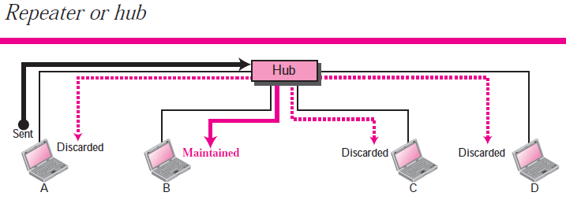
Repeater forwards every bit; it has no filtering capability.
A hub or a repeater is a physical-layer device. They do not have any data-link
address and they do not check the data-link address of the received frame.

Slide 49
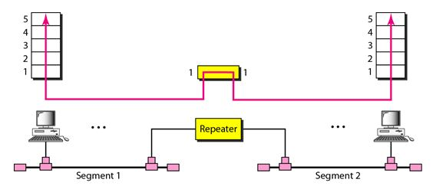

Slide 50
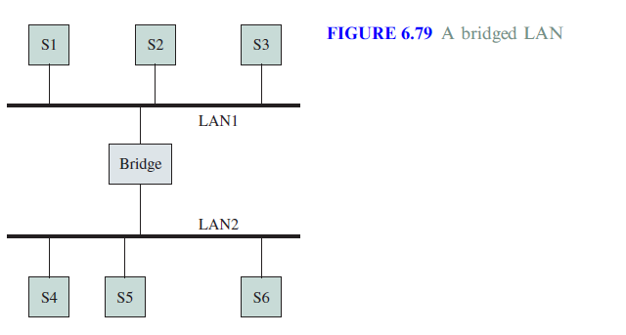
Bridges
Why Bridges ?
There may be requirement in the organization that- they need to interconnect the departmental LANs in order to share the resources.
Thus Bridges are used for connecting multiple LANs as shown in the figure.
Bridged LAN or Extended LAN
Notes:
Why Bridges

Slide 51
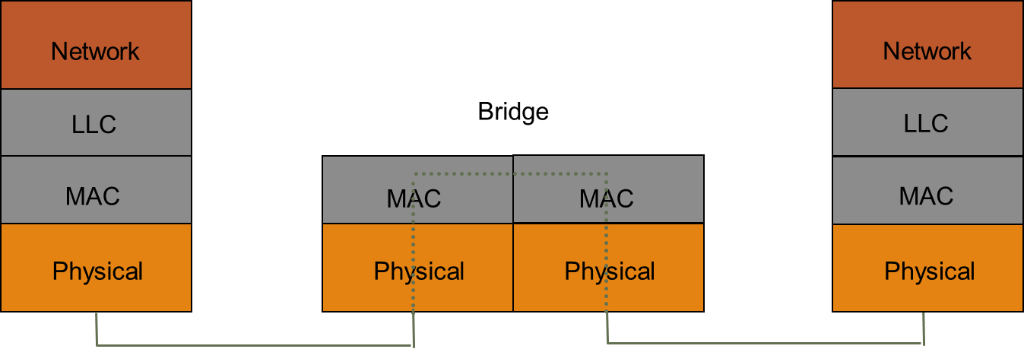
Bridges
A bridge operates in both the physical and the data link layers.
As a physical-layer device-
it regenerates the signal it receives.
As a data link layer device,-
it can check the MAC addresses (source and destination) contained in the frame.

Slide 52
Types of Bridges
There are two types of bridges which are widely used:
Transparent Bridges: These bridges are widely used in Ethernet LANs
Source Routing Bridges: These bridges are widely used in Token Ring LANs and FDDI networks

Slide 53
Transparent Bridges
These bridges were defined by the 802.1d committee.
The term transparent refers to the fact that the stations are completely unaware of the presence of the bridges in the network
Thus introducing a bridge doesn’t require the stations to be configured.
Following are the functions of the transparent bridges:
Forward Frames from one LAN to another
Learn which stations are attached to a given LAN
Avoid Loops in the topology

Slide 54
Bridge Learning
When frame arrives on one of the ports of the bridge, the bridge has to decide whether it has to forward the frame.
To do so it needs to maintain a table called as the forwarding table or forwarding database
Use table lookup, and
discard frame, if source & destination in same LAN
forward frame, if source & destination in different LAN
use flooding, if destination is unknown.
Use backward learning to build table
observe source address of arriving LANs
handle topology changes by removing old entries
Notes:
Backward learning : tables at each bridge gets modified by information from the incoming packets
The Basic process works as follows-
When a bridge receives a frame
-Compares Source address with each entry in the forwarding Table.
If entry do not exists then it adds to forwarding table (Source MAC & Port from which frame is received)
-Compares Destination address with each entry in the forwarding Table.
If entry is found then forwards the frame to the port indicated in the entry. If the port number entry is same as port number on which frame is received then No Forwarding and Frame is discarded.
- If the port entry is not found in the table then “flood” the frame on all ports except the one through which the frame was received.
From CISCO
Bridges and switches extend the effective length of a LAN. Bridges are capable of filtering frames based on any Layer 2 fields. For example, a bridge can be programmed to reject (not forward) all frames sourced from a particular network. Bridges are generally used to segment a LAN into a couple of smaller segments. Bridges generally have only a few ports for LAN connectivity, whereas switches generally have many

Slide 55
Example: How Table is built ?
S1
S2
S3
S4
S5
LAN1
LAN2
LAN3
B1
B2
Port 1
Port 2
Port 1
Port 2
Address Port
Address Port
Notes:
How entries are filled ?
Admin can record and load up during system start up. Not desirable
The Basic process works as follows- 6.11.1 Garcia
When a bridge receives a frame
-Compares Source address with each entry in the forwarding Table.
If entry do not exists then it adds to forwarding table (Source MAC & Port from which frame is received)
-Compares Destination address with each entry in the forwarding Table.
If entry is found then forwards the frame to the port indicated in the entry. If the port number entry is same as port number on which frame is received then No Forwarding and Frame is discarded.
- If the port entry is not found in the table then “flood” the frame on all ports except the one through which the frame was received.
Example: How Table is built

Slide 56
S1→S5
S1
S2
S3
S4
S5
S1 to S5
S1 to S5
S1 to S5
S1 to S5
LAN1
LAN2
LAN3
B1
B2
Port 1
Port 2
Port 1
Port 2
Address Port
Address Port
S1
1
S1
1

Slide 57
S3→S2
S1
S2
S3
S4
S5
S3→S2
S3→S2
S3→S2
S3→S2
S3→S2
LAN1
LAN2
LAN3
B1
B2
Port 1
Port 2
Port 1
Port 2
Address Port
Address Port
S1
1
S1
1
S3
2
S3
1
Notes:
Note: S3-> S2 in Lan3 is waste, since S2 lies in the Lan1 , but as per rule S3->S2 is forwarded into LAN3

Slide 58
S4→S3
Details of S4 will be recorded in both B1 and B2 because S3 and B1 are connected in bus topology, therefore if a packet is forwarded it is received by all the nodes connected to the LAN
S1
S2
S3
S4
S5
S4 S3
S4→S3
S4→S3
S4→S3
LAN1
LAN2
LAN3
B1
B2
Port 1
Port 2
Port 1
Port 2
Address Port
Address Port
S1
1
S1
1
S3
2
S3
1
S4
2
S4
2

Slide 59
S2→S1
S1
S2
S3
S4
S5
S2→S1
LAN1
S2→S1
LAN2
LAN3
B1
B2
Port 1
Port 2
Port 1
Port 2
Address Port
Address Port
S1
1
S1
1
S3
2
S3
1
S4
2
S4
2
S2
1
S2->S1 Traffic is completely isolated now,
What happens if S4->S2 now.
Note that bridges change collision domains.
Notes:
Traffic is completely isolated now. S2 traffic not forwarded to LAN2 , remains at LAN1 only (Because, both S2,S1 locations are known to B1).
So Now B2 will not learn where S2 is. Here Learning Stops, but nothing remains static.
Nothing stays static in real life. What if station moves from one LAN to other.
Bridges can adopt to Dynamics of the Network.
For each entry , a timer(of order some minutes) is maintained(time stars when entry made in the table).
With in the timer , if frame from a source is received and that entry exist in the table then timer is refreshed.
If for an existing entry timer expires then bridge removes the entry from the table.
When a bridge receives a frame from a station that was in say LAN1 and moved to LAN2 then relearning and entry is done in the Bridge.

Slide 60
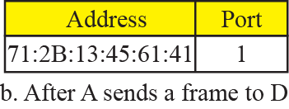
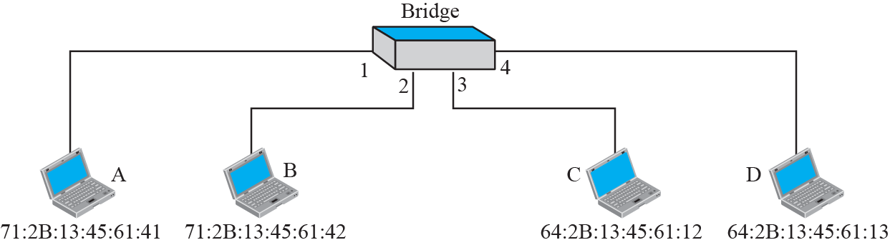
Example-Learning bridge

Slide 61
Adaptive Learning
Bridges can adopt to Dynamics of the Network
In a static network, tables eventually store all addresses & learning stops
In practice, stations are added & moved all the time
Introduce timer (minutes) to age each entry & force it to be relearned periodically
If frame arrives on port that differs from frame address & port in table, update immediately
Two-Layer Switch
A two-layer switch performs at the physical and data link layer; it is a sophisticated bridge with faster forwarding capability.
Notes:
A three-layer switch is a router, but a faster and more sophisticated.

Slide 62
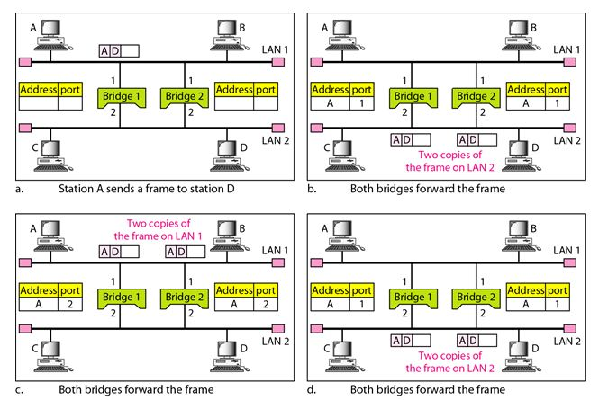
Problem: Loops in the topology
Even though redundant Bridge make the network more reliable, but can create loops in the system, which is very undesirable.
The spanning tree algorithm is used to create a loop less topology
Notes:
Transparent bridges work fine as long as there are no redundant bridges in the system. Systems administrators, however, like to have redundant bridges (more than one bridge between a pair of LANs) to make the system more reliable. If a bridge fails, another bridge takes over until the failed one is repaired or replaced. Redundancy can create loops in the system, which is very undesirable.
Even though redundant Bridge make the network more reliable, but can create loops in the system, which is very undesirable.
To solve the looping problem, the bridges use the spanning tree algorithm to create a loop less topology.

Slide 63
Routers
A router is a three-layer device; it operates in the physical, data link, and network layers.
physical layer device, it regenerates the signal it receives.
data link layer device, the router checks the physical addresses (source and destination).
network layer device, a router checks the network layer addresses(addresses in the IP layer)
A router can connect LANs/WANs/LAN and WAN together. So Router is a an internetworking device; it connects independent networks together to form an internetwork.
A router is a three-layer (physical, data link, and network) device.
Notes:
Note that bridges change collision domains, but routers limit broadcast domains.

Slide 64
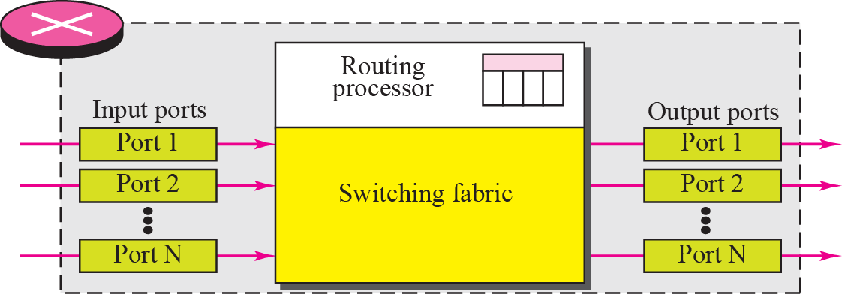
Structure of Router
Components :
Input ports, Output ports, the Routing processor, and the Switching fabric
Notes:
Structure of Router

Slide 65
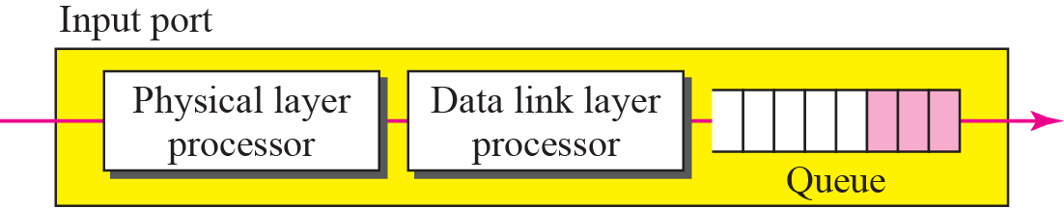
Input port
An input port performs the physical and data link layer functions of the router.
The bits are constructed from the received signal.
Decapsulated from the frame. Errors are detected and corrected
Packet is stored into input port buffer queue for further forwarding job.

Slide 66
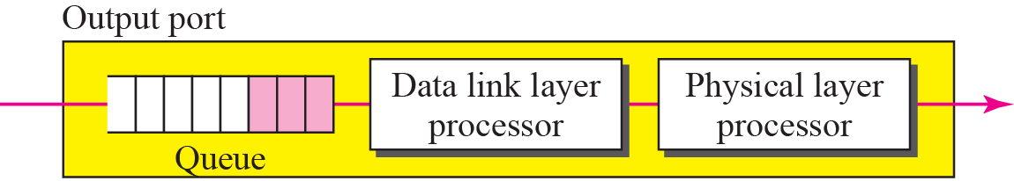
Output port
An output port performs the same functions as the input port, but in the reverse order.
Once packet is forwarded from input port buffer to output port buffer.
Outgoing packets are queued into output port buffer.
The packet is encapsulated in a frame.
Finally the physical layer functions are applied to the frame to create the signal to be sent

Slide 67
Routing Processor
The routing processor performs the functions of the network layer.
The destination address is used to find the address of the next hop and, at the same time, the output port
number from which the packet is sent out. This activity is sometimes referred to as table lookup because the routing processor searches the routing table.

Slide 68
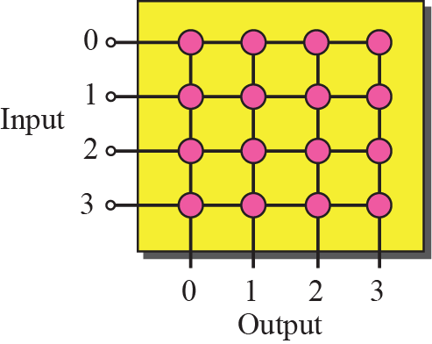
Crossbar switch
Switching fabric is responsible for moving the packet from the input queue to the output queue.
The simplest type of switching fabric is the crossbar switch.
A crossbar switch connects n inputs to n outputs in a grid, using electronic microswitches at each Crosspoint.
Similarly other kind of switches- Banyan Switch, Batcher-Banyan Switch

Slide 69
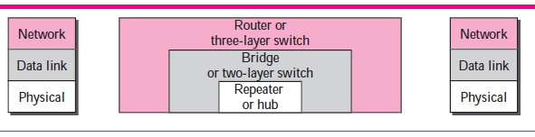
Connecting Devices and Layers
Notes:
Connecting Devices and Layers

Slide 70
END OF CHAPTER
Notes:
END OF CHAPTER

